Slide 1

MDM Solution Using WSO2 Iot Server
PRESENTED BY : SIBAJI KHATAI

Slide 2
Content
Mobile Device Management
Architecture
System Requirements
Working with Devices
Working with Android Devices

Slide 3
Mobile Device Management (MDM)
WSO2 EMM manages the Android, iOS, and Windows mobile devices of your workforce. Does your organization allow employees to bring their own devices to work, or does it provide corporate-owned devices to employees? WSO2 EMM allows you to enroll Bring Your Own Devices (BYOD) and Corporate Owned, Personally Enabled (COPE) devices.
With WSO2 EMM, you can:
Install the WSO2 EMM profile on the device. You can choose the BYOD or COPE enrollment path for the device.
Apply policies on devices so that they adhere to company security policies, such as disabling the device's camera when the device enters a certain geo area.
Customize the device enrollment process to enroll Corporate Owned, Single Use (COSU) and more.
Remotely control, upgrade the firmware, wipe data, transfer files, and much more.
Add geofences, monitor, and analyze device data using real-time analytics.
Group and manage devices in one go.

Slide 4
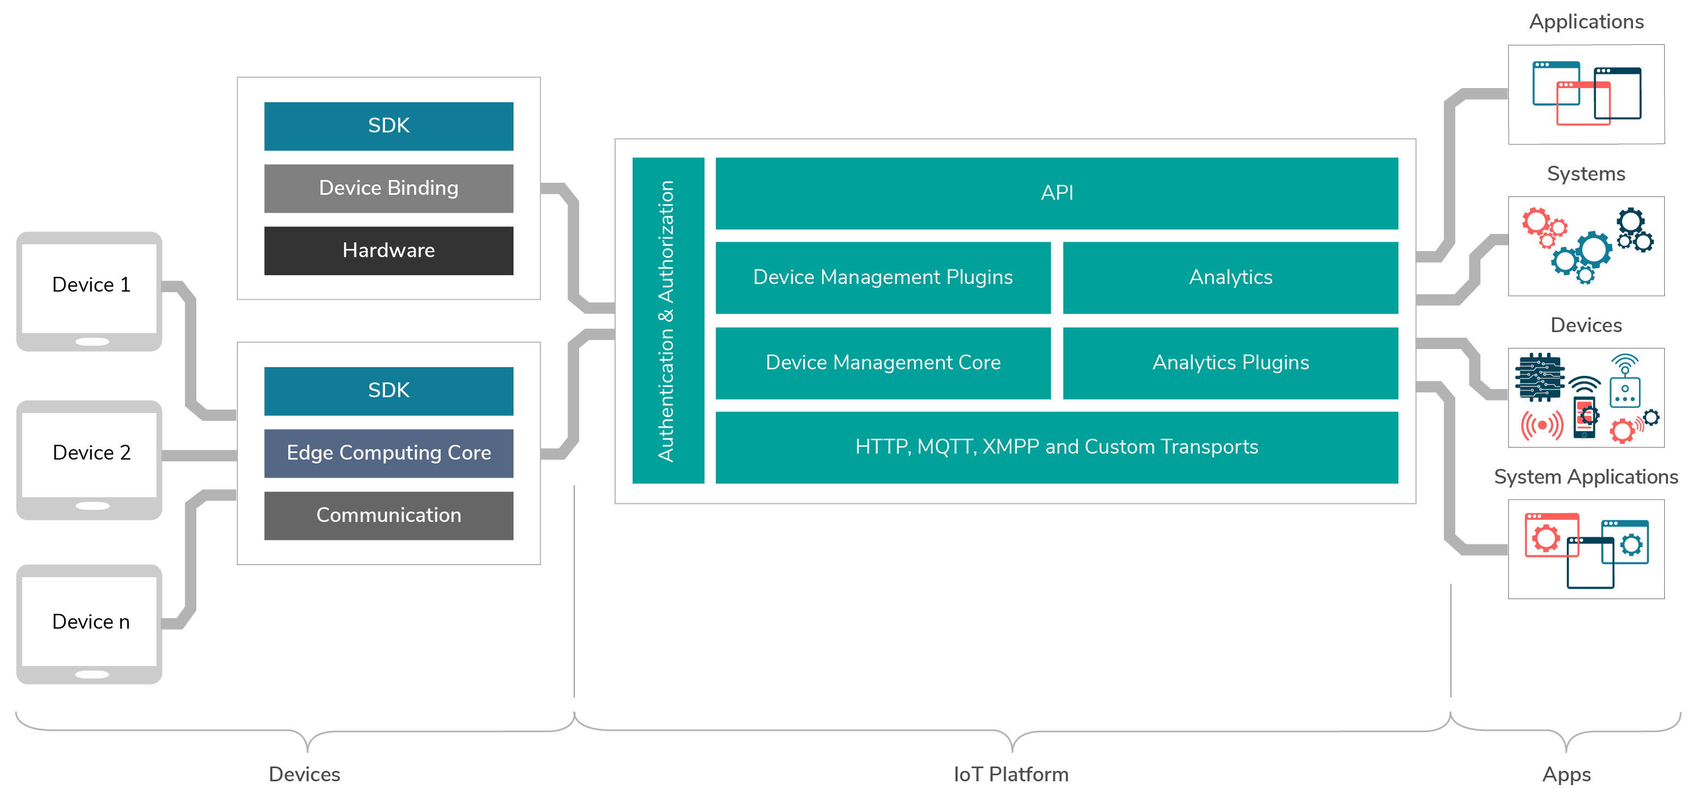
Architecture

Slide 5
System requirements
WSO2 Enterprise Mobility Manager (WSO2 EMM) is bundled inside WSO2 IoT Server
Following are the minimum system requirements to run all the IoT components.
Memory -> 8 GB minimum (16 GB is recommended for a production environment.)
Disk -> ~ 5 GB, excluding space allocated for log files, mobile applications, and databases.
Operating Systems / Databases -> All WSO2 Carbon-based products are Java applications that can be run on any platform that is JDK 8 compliant. however, we recommend you use an industry-standard RDBMS such as Oracle, PostgreSQL, MySQL, MS SQL, etc
Required applications
==============================
The following applications are required for running the product and its samples or for building from the source code. Mandatory installs are marked with an asterisk * .
Application Name Version
============================================================
* Java SE Development Kit (JDK) 1.8
Apache ActiveMQ JMS Provider 5.5.0 or later
Apache Ant 1.7.0 or later
Apache Maven 3.0.X
Git 1.8.*
Web Browser

Slide 6
Working with Devices
WSO2 Enterprise Mobility (WSO2 EMM) capabilities are bundled with WSO2 IoT Server. Therefore, it is a comprehensive open source platform that enables organizations to secure, manage, and monitor Android, iOS, Windows, and any IoT devices.
Before working with any device we have to set up first IOT server on the machine .
This is the url for IOT server https://wso2.com/solutions/enterprise-mobility/enterprise-mobility-management/#download
After download the software we have to keep the software in any specified location after that we have start the server according to the platform wise .
d <IOTS_HOME>/bin
./iot-server.sh --> for Linux/MAC/Solaris
iot-server.bat --> for Windows

Slide 7
Working with Android device
Here we will see following activities with android device.
Creating users and a sample policy
Registering the Android device
Updating the passcode policy
Publishing Applications
Adding new Applications
Trying out Android device operations
Installing an application on the Android device

Slide 8
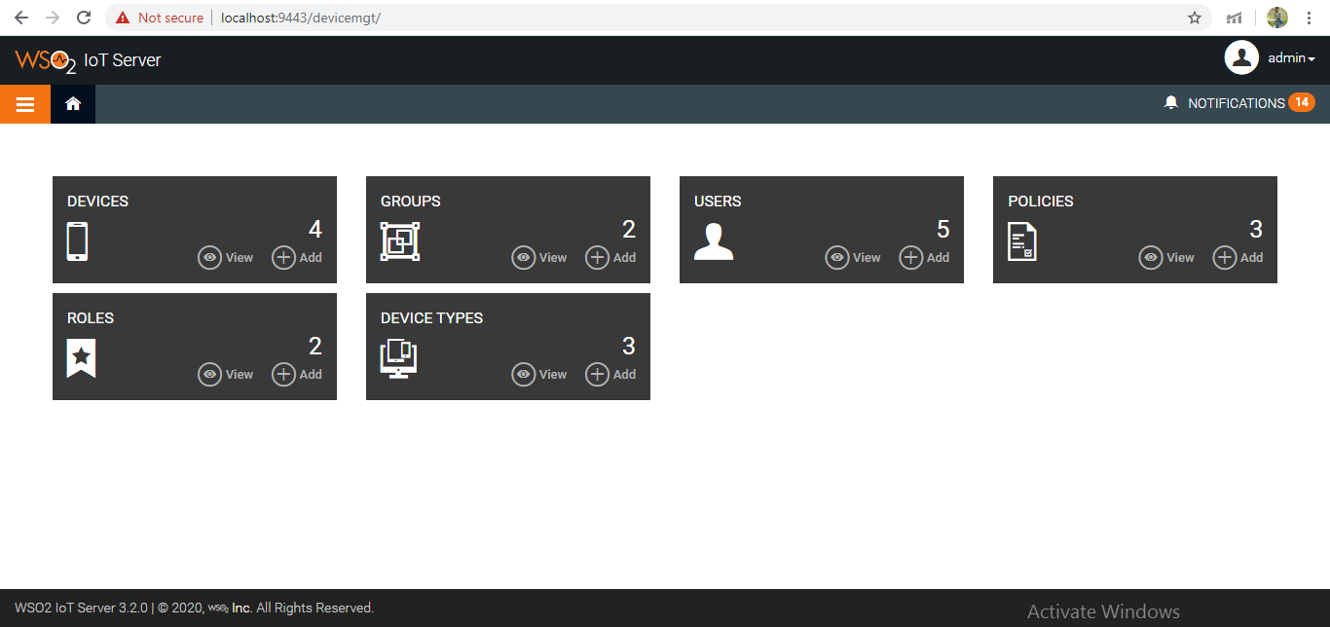
Access the WSO2 device management
Access the WSO2 device management console by navigating to https://<EMM_HOST>:9443/devicemgt. Use admin as the username and the password. You will see the Admin role and the Admin user.

Slide 9
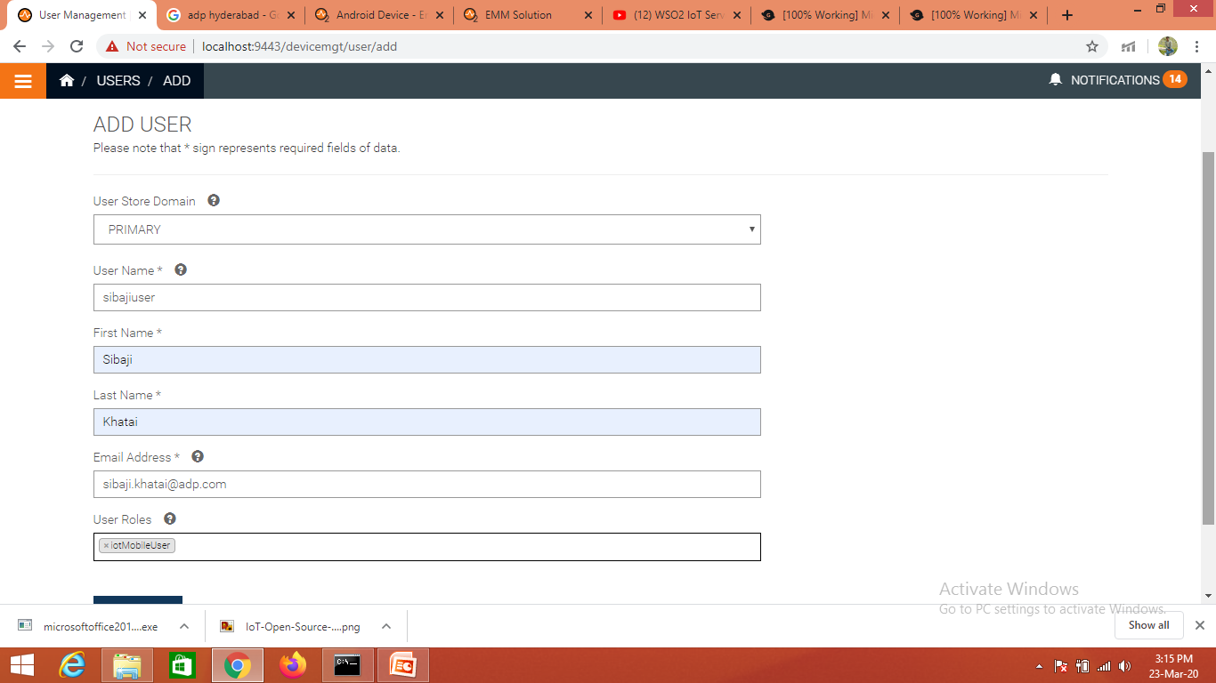
Creating users
After logged into device management console ,click on the add option of user tab.

Slide 10
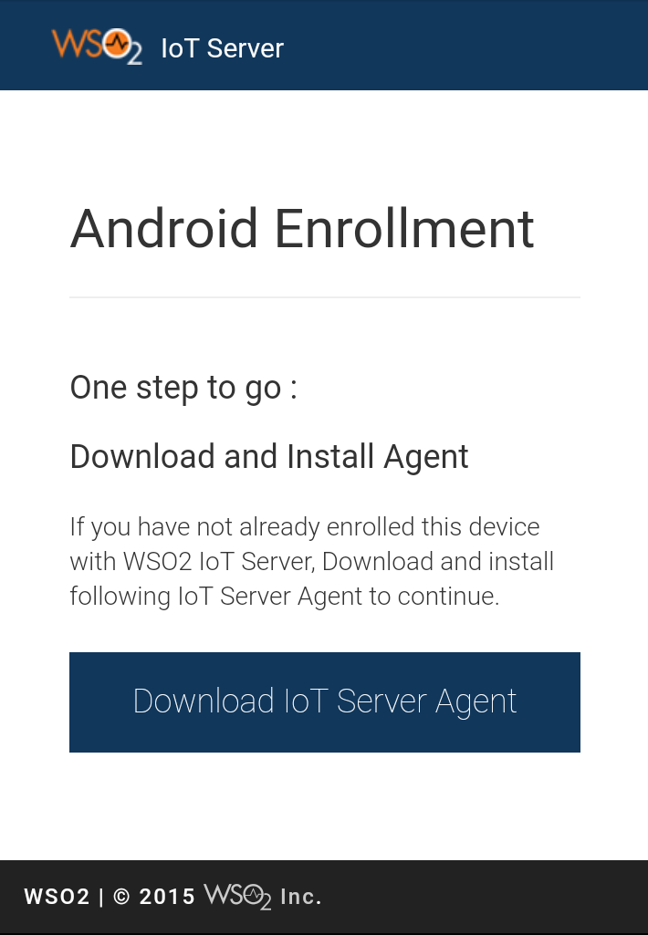
Registering the Android device
Sign in to the WSO2 EMM device management console using sibajiuser as the username and sibajiuser as the password.
Click Enroll New Device.
Click Android to enroll your device with WSO2 EMM.
Scan the QR code to download the Android agent onto your Android device.
sibajiuser taps Download IoT Server Agent on this screen.

Slide 11
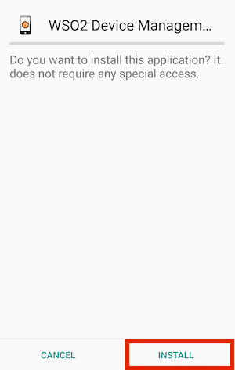
Registering the Android device
Tap INSTALL to start installing the Android agent.

Slide 12
Registering the Android device
Tap OPEN, once the WSO2 Agent is successfully installed.
Tap SKIP AND GO TO ENROLLMENT, which will direct you to install the device with WSO2 IoT Server in the default manner.
Enter the server IP and the port as your server address in the text box provided and tap START REGISTRATION.
Example: Register the device via HTTP: 192.168.43.136:8280
Enter your details and tap SIGN IN. A confirmation message will appear..
Organization - In this example, sibajiuser leaves the Organization empty, as it is only required if the server is hosted with multi-tenant support.
Username - Enter sibajiuser as the username.
Password - Enter sibajiuser as the password.

Slide 13
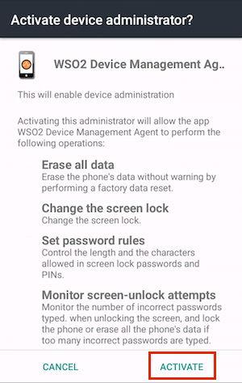
Registering the Android device
Read the policy agreement, and tap Agree to accept the agreement.
Tap ACTIVATE to enable the WSO2 EMM device administrator on your device. A confirmation message appears after enabling the device admin.

Slide 14
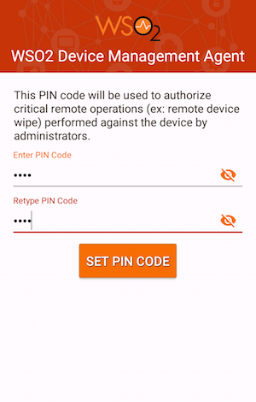
Registering the Android device
Tap ALLOW to allow the WSO2 Android agent to make and manage phone calls, and to access photos, media, files, and the device location.
Sibajiuser sets a PIN code with a minimum of four digits and taps SET PIN CODE. The PIN code is used to secure your personal data.

Slide 15
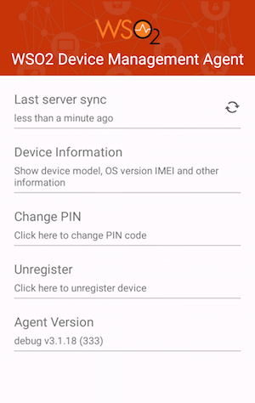
Registering the Android device
You have now successfully registered your Android device. Tap Device Information to get device specific information, and tap Unregister if you wish to unregister your device from WSO2 EMM.

Slide 16
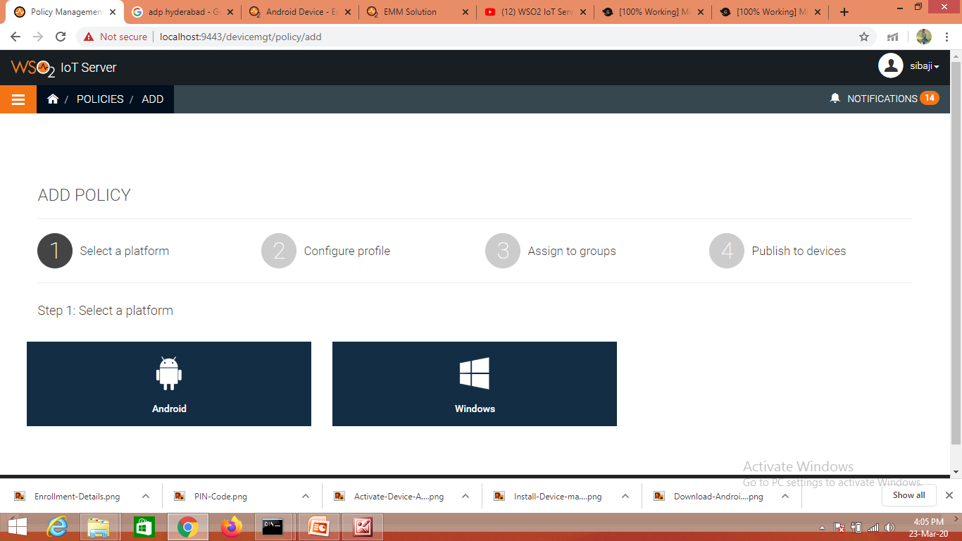
Adding/Creating Policy
Check out the WSO2 EMM dashboard by signing in to the WSO2 IoT Server console using sibaji as the username and sibaji as the password: https://<EMM_HOST>:9443/devicemgt.
You will then see the new iotMobileUser role, 3 new policies
To create policy click add button on policies tab of device manament console . Then select plat form e.g. Android

Slide 17
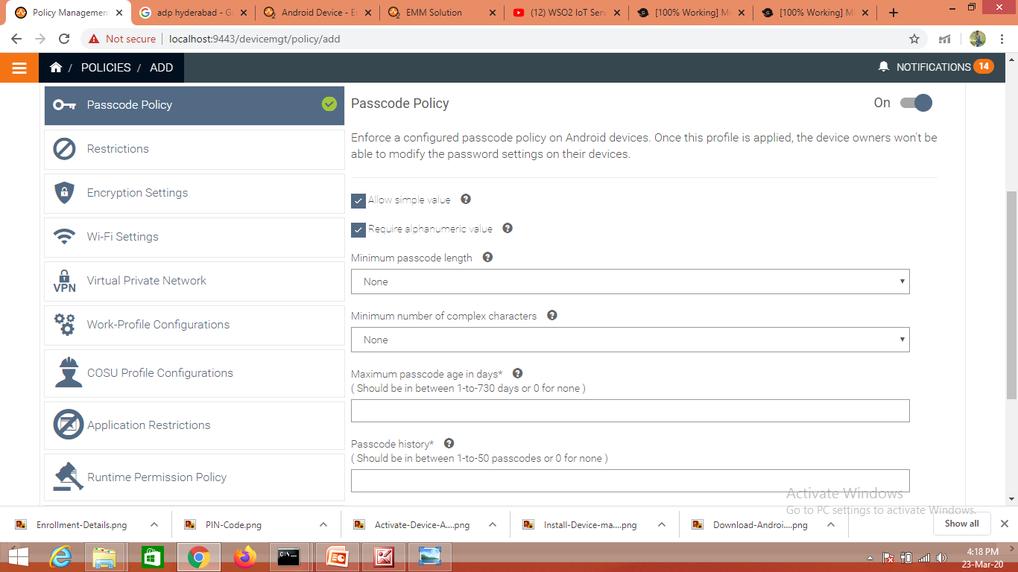
Adding/Creating Policy
Lets click on the passcode policy apply some min length and apply Maximum number of failed attempts then click on continue .

Slide 18
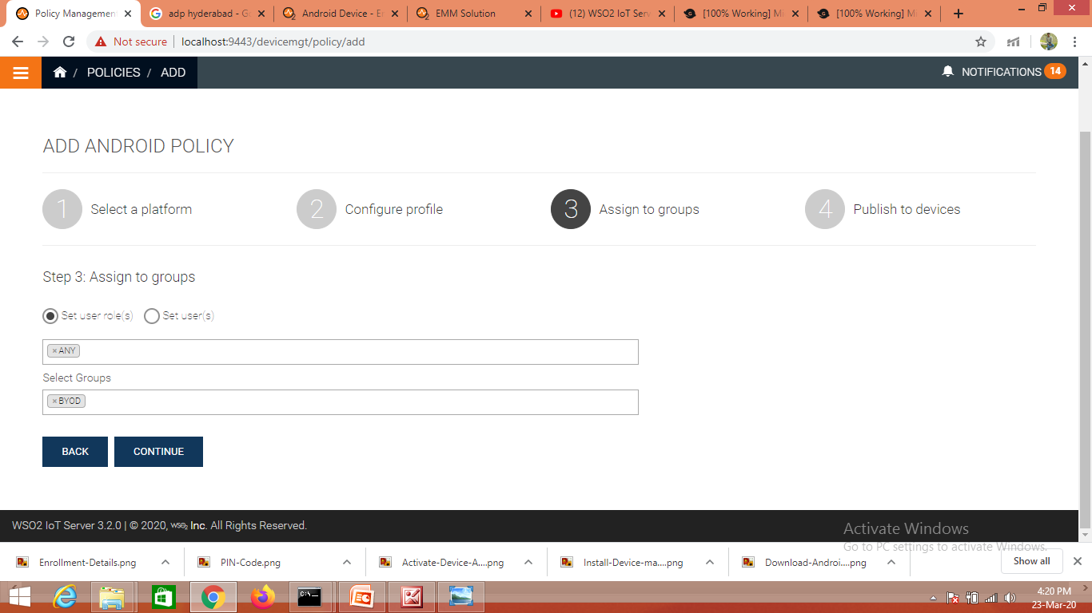
Adding/Creating Policy
then select user role and select group.

Slide 19
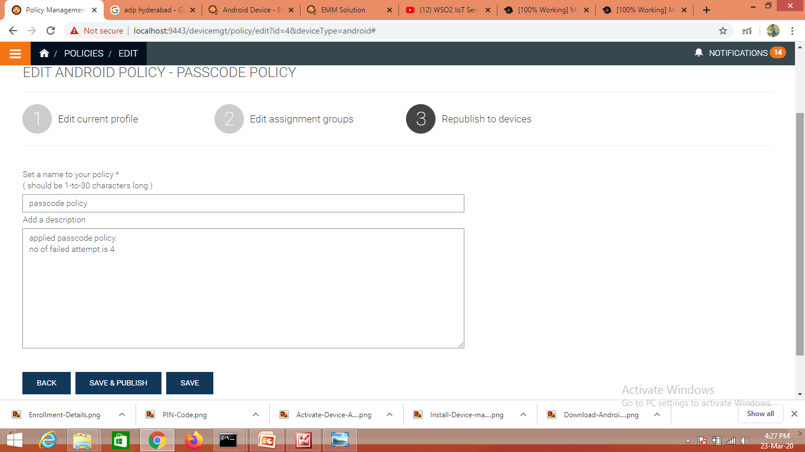
Adding/Creating Policy
Click on the continue button ,then enter the policy name and policy description . Then click on the publish button .

Slide 20
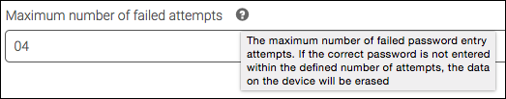
Updating the passcode policy
Click the edit icon that is on the passcode policy for Android devices.
Update the passcode profile that is already in place by defining the maximum fail attempts as 4, and click CONTINUE.
Update the user group .
Then click on the continue .then update passcode policy .
Click SAVE & PUBLISH to make policy active.

Slide 21
Publishing Applications
Navigate to the App Publisher using the following URL: https://<EMM_HOST>:9443/publisher. Use sibaji as the username and sibaji as the password.
Click Submit for Review for the WSO2Con-Android application.
Click Approve and then click Publish. The App Catalog application is now published.

Slide 22
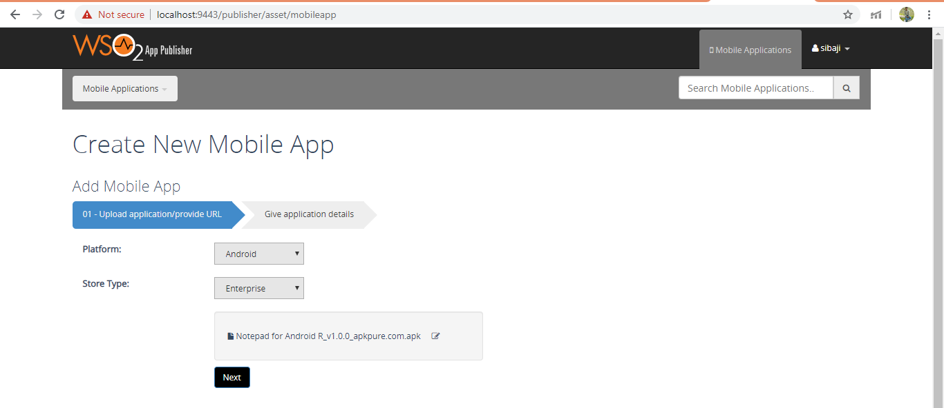
Adding new application
Add new mobile application option on the Publisher console.
Select platform , store type and select .apk file then click on next button

Slide 23
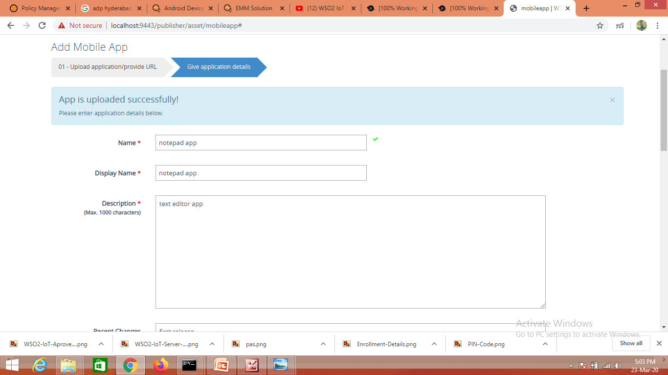
Adding new application
Here give the application details like name,displayname,description,version,category,banner,iocn etc.

Slide 24
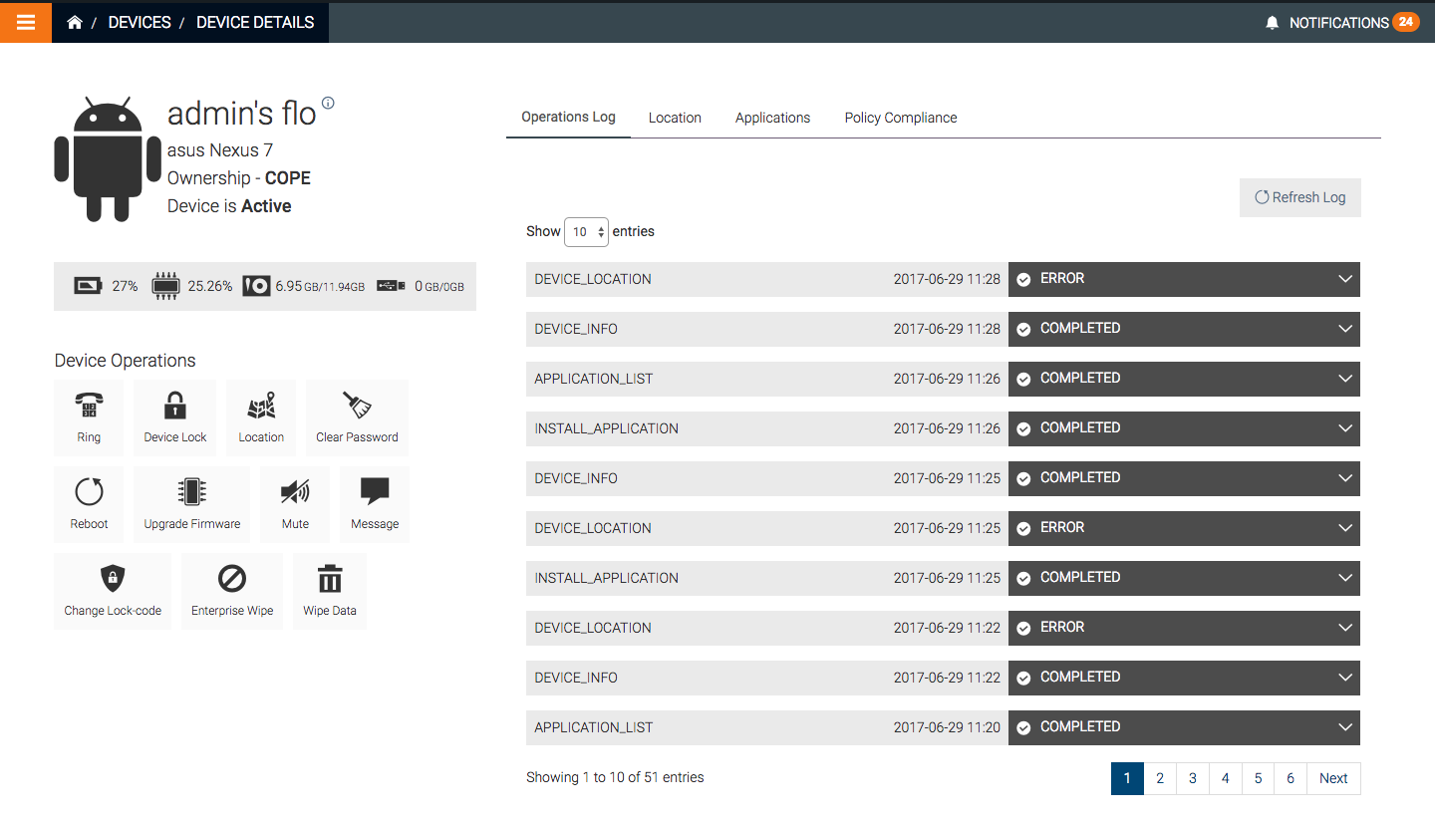
Trying out Android device operations
Access the WSO2 EMM's device management console using sibajiuser as the username and sibajiuser
Click View under DEVICES.
sibajiuser tries out the various device operations via the WSO2 EMM console.

Slide 25
Trying out Android device operations
sibajiuser misplaces the mobile device, so sibajiuser clicks Ring to ring the device and find out if the device is lying around the workspace.
sibajiuser then remembers that the phone was unlocked, so sibajiuser uses the Device Lock operation to lock the device so that the content in the device will be safe.
Using the Location operations sibajiuser finds out that device is in sibaji's office. sibajiuser calls sibaji and asks sibaji to call back from the device.
To make sure sibaji can call using the device, sibajiuser removes the device lock (password) using the Clear Password operation
Get the device's installed application list.
Enable the silent profile on the device or mute the device.
Send a message to the device. The device administrator can use this device etc…

Slide 26
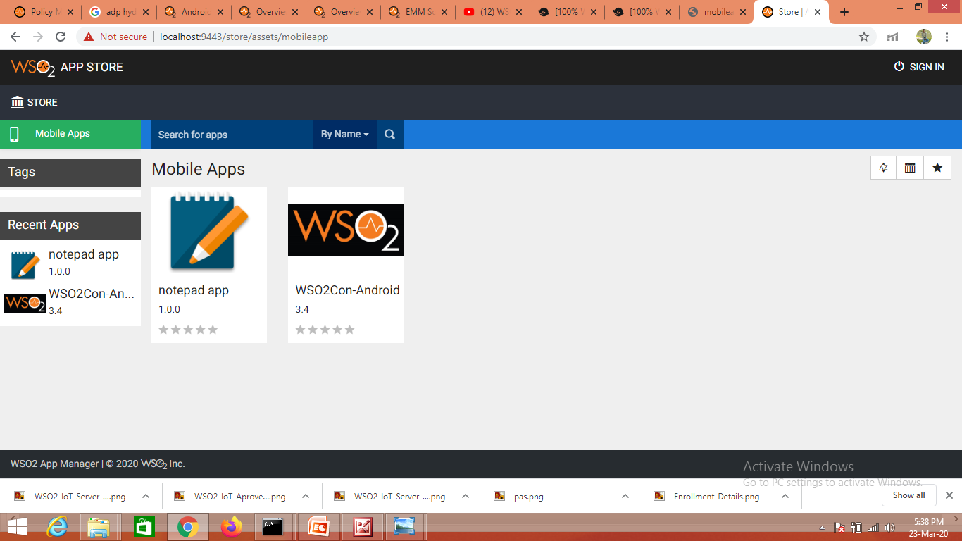
Installing an application on the Android device
Let's take a look at how sibajiuser installs this application on the device.
Navigate to the App Store using the following URL: https://<IOTS_HOST>:9443/store
Sign in using sibajiuser and sibajiuser as the username and password.
Click on the Mobile apps

Slide 27
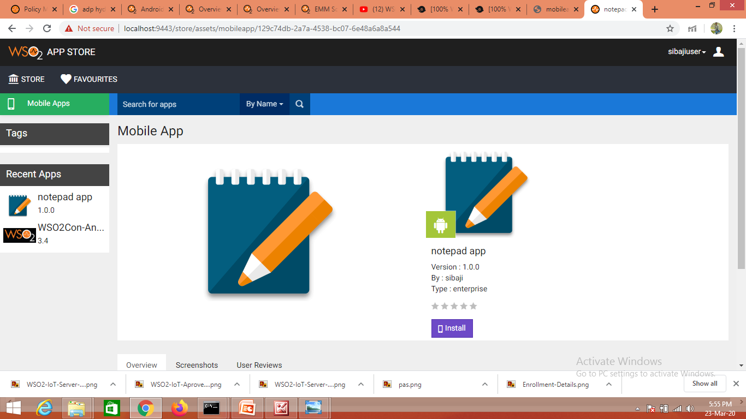
Installing an application on the Android device
Click on the app which one you want to install, then click on the install.

Slide 28
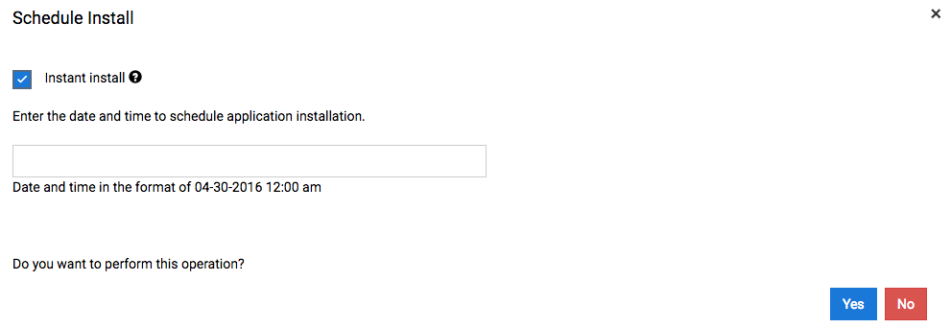
Installing an application on the Android device
Select Instant install, and click Yes.
Click on your device in the pop-up menu to install and subscribe to the application.
A success message will be shown when you have successfully subscribed to the application.
Tap Install on your device to finish installing the application.
Now you can use start using the application.

Slide 29


